Slide 1
Cache Sample Problems
CDA 3101

Slide 2
Memory Hierarchy
Data Movement Occurs Across Memory Hierarchy
Access Latencies Differ Widely
Register < L1 Cache < L2 Cache < Main Memory < Disk < Archival
Memory Performance Can be Maximized
Maximize Data Transfers in Fast Memory (e.g. Registers <-> Cache)
Minimize Data Transfers in Slow Memory (e.g. Registers <-> Main Memory)
Place data most likely to be accessed (needed in a register) in fast memory

Slide 3
Sample Configuration of Cache Memory

Slide 4
Cache Memory
Blocks containing a desired item are loaded into cache
Blocks may contain hundreds of bytes
Takes advantage of spatial locality
Blocks are copied from main memory into L2 and L1 cache
L1 contains a subset of information in L2
Cache line holds a block read from main memory
Blocks and lines are the same size
Blocks are in main memory, lines are in cache

Slide 5
Lookaside Cache
Accesses to cache and to main memory occur in parallel
Main memory access is cancelled if hit in cache occurs
Tends to lower average memory access time
Increases CPU to memory traffic
Average memory access time (AMAT) = hit ratio*TC + (1-hit ratio)*TM

Slide 6
Look Through Cache
First level cache is checked first
Next level is only checked if miss occurs
Tends to increase average memory access time
Avoids unneeded CPU-to-memory traffic
AMAT = hit ratio*TC + (1-hit ratio)*(TC+TM) = TC + (1-hit ratio)*TM

Slide 7
Example Problem 1
Consider a system with a main memory access time of 50 ns supported by a cache having a 8 ns access time and a hit rate of 95%.
What is the average memory access time for a look aside cache?
What is the average memory access time for a look through cache?

Slide 8
Example Problem 1 Step 1
Consider a system with a main memory access time of 50 ns supported by a cache having a 8 ns access time and a hit rate of 95%.
What is the average memory access time for a look aside cache?
Hit ratio = 0.95
AMAT = 0.95*8 + 0.05*50 = 10.1 ns
What is the average memory access time for a look through cache?

Slide 9
Example Problem 1 Step 2
Consider a system with a main memory access time of 50 ns supported by a cache having a 8 ns access time and a hit rate of 95%.
What is the average memory access time for a look aside cache?
Hit ratio = 0.95
AMAT = 0.95*8 + 0.05*50 = 10.1 ns
What is the average memory access time for a look through cache?
AMAT = 0.95*8 + 0.05(8 + 50) = 8 + 0.05*50 = 10.5 ns

Slide 10
Example Problem 2
Consider a system with a main memory access time of 50 ns supported by an L1 cache having a 8 ns access time and a hit rate of 95% and an L2 cache having a 15 ns access time and a hit rate of 90%
What is the average memory access time for a look aside cache?
What is the average memory access time for a look through cache?

Slide 11
Example Problem 2 Step 1
Consider a system with a main memory access time of 50 ns supported by an L1 cache having a 8 ns access time and a hit rate of 95% and an L2 cache having a 15 ns access time and a hit rate of 90%
What is the average memory access time for a look aside cache?
8*0.95 + 0.05(15*0.9 + 50*0.1) = 8.525 ns
What is the average memory access time for a look through cache?

Slide 12
Example Problem 2 Step 2
Consider a system with a main memory access time of 50 ns supported by an L1 cache having a 8 ns access time and a hit rate of 95% and an L2 cache having a 15 ns access time and a hit rate of 90%
What is the average memory access time for a look aside cache?
8*0.95 + 0.05(15*0.9 + 50*0.1) = 8.525 ns
What is the average memory access time for a look through cache?
8 + 0.05*(15 + 50*0.1) = 9 ns

Slide 13
Sources of Misses
Compulsory Misses
Also called “cold start” misses
Unavoidable due to initially empty cache
Capacity
Due to limited size of cache
Conflict
Due to different blocks mapping to the same cache line

Slide 14
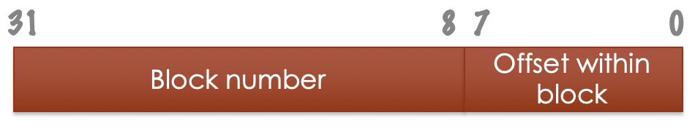
Cache Organization
Main memory is split into blocks - blocks will be loaded into cache
Addresses of items map to blocks
Block number = address/block size
Number of bits in offset = log₂ block size
Example: for 256-byte blocks, the address 0x0400ACE8 falls within block: 0x400ACE8/256=0x00400AC
Offset width = log₂ 256 = 8 bits

Slide 15
Example Problem 3
Memory Address | Block | Offset
0000 | 00 | 00
0001 | 00 | 01
0010 | 00 | 10
0011 | 00 | 11
0100 | 01 | 00
0101 | 01 | 01
0110 | 01 | 10
0111 | 01 | 11
1000 | 10 | 00
1001 | 10 | 01
1010 | 10 | 10
1011 | 10 | 11
1100 | 11 | 00
1101 | 11 | 01
1110 | 11 | 10
1111 | 11 | 11
Main memory size = 16 bytes = 2⁴ bytes
Address is log(16) = 4 bits
Block size = 4 bytes = 2² bytes
Width of offset field is log(4) = 2 bits
Block number = 4-2 = 2 bits

Slide 16
Example Problem 3 Step 1
Memory Address | Block | Offset
0000 | 00 | 00
0001 | 00 | 01
0010 | 00 | 10
0011 | 00 | 11
0100 | 01 | 00
0101 | 01 | 01
0110 | 01 | 10
0111 | 01 | 11
1000 | 10 | 00
1001 | 10 | 01
1010 | 10 | 10
1011 | 10 | 11
1100 | 11 | 00
1101 | 11 | 01
1110 | 11 | 10
1111 | 11 | 11
Main memory size = 16 bytes = 2⁴ bytes
Address is log(16) = 4 bits
Block size = 4 bytes = 2² bytes
Width of offset field is log(4) = 2 bits
Block number = 4-2 = 2 bits
Example: memory address 9₁₀ = 1001₂
Block number = floor(9/4) = 2₁₀ = 10₂
Or, just take the first two bits = 10
Offset = 01
How far in the block to we have to go to find the item requested?

Slide 17
Example Problem 4
Main memory of 65,536 bytes is split into blocks of 512 bytes.
How many bits wide is the memory address?
How many bits wide is the offset field?
How many bits describe the block?

Slide 18
Example Problem 4 Answer
Main memory of 65,536 bytes is split into blocks of 512 bytes.
How many bits wide is the memory address?
log(65536) = 16
How many bits wide is the offset field?
log(512) = 9
How many bits describe the block?
16 - 9 = 7 bits

Slide 19
Cache Organization
Cache can hold some number of blocks
The blocks within the cache are called lines
Each line is the same size as a memory block
A line can hold one of a collection of blocks
Mapping determines which line contains which block
Number of lines is much smaller than number of blocks
Main memory size / block size = number of blocks
Cache size / block size = number of lines
If cache size = 2¹³ bytes and block size is 256 bytes, number of lines = 2¹³ B/ 2⁸ B = 2⁵ = 32 lines

Slide 20
Example Problem 5
A system has a main memory of 2³² bytes and a block size of 1024 bytes. It has a cache with 16,834 bytes.
How many bits are in the memory address?
How many blocks are in main memory?
What is the size of the offset field?
How many lines are in the cache?

Slide 21
Example Problem 5 Answer
A system has a main memory of 2³² bytes and a block size of 1024 bytes. It has a cache with 16,834 bytes.
How many bits are in the memory address?
log(2³²) = 32
How many blocks are in main memory?
1024 = 2¹⁰
232 bytes / (1024 bytes/block) = 2³² / 2¹⁰ = 2²² blocks
How many bits are in the offset field?
Log(2¹⁰) = 10
How many lines are in the cache?
16,834 = 2¹⁴
2¹⁴ bytes/cache / 2¹⁰ bytes/line = 2⁴ lines/cache

Slide 22
Fully Associative
Any memory block can go into any empty cache line
All lines are checked to detect cache hits or misses
Requires hardware to compare all lines in parallel
A valid bit for each line is set if the line is occupied
Block loaded into vacant cache line if miss occurs
If no line is vacant a replacement must occur

Slide 23
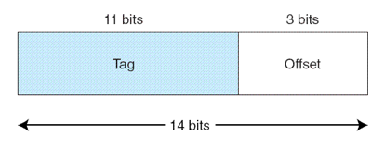
Fully Associative
Mapping is based on dividing address into two fields
Tag field and offset
A separate tag is stored for each cache line
If a stored tag matches the tag field in the address and the line is valid, there is a hit.
Example: 14-bit addresses and a cache containing 16 lines. Each line is 8 bytes in size. Offset field width in bits = log₂(line size)

Slide 24
Fully Associative

Slide 25
Example Problem 6
A system with 2³² bytes of main memory has a fully associative cache with 2¹⁰ bytes and a line size of 2⁴ bytes.
How many bits are in the address?
How many bits are in the offset field?
How many bits are in the tag (or block) field?
How many lines are in the cache?

Slide 26
Example Problem 6 Answer
A system with 2³² bytes of main memory has a fully associative cache with 2¹⁰ bytes and a line size of 2⁴ bytes.
How many bits are in the address? log(2³²) = 32
How many bits are in the offset field? log(2⁴ ) = 4
How many bits are in the tag (or block) field? 32 – 4 = 28
How many lines are in the cache? (2¹⁰ bytes/cache) / (2⁴ bytes/line) = 2⁶ lines/cache

Slide 27
Example Problem 6 Step 2
A system with 2³² bytes of main memory has a fully associative cache with 2¹⁰ bytes and a line size of 2⁴ bytes.
How many bits are in the address? 32
How many bits are in the offset field? 4
How many bits are in the tag (or block) field? 32 – 4 = 28
How many lines are in the cache? (2¹⁰ bytes/cache) / (2⁴ bytes/line) = 2⁶ lines/cache
A request is made for the byte at address 0x12345678. What is the tag?

Slide 28
Example Problem 6 Step 2 Answer
A system with 2³² bytes of main memory has a fully associative cache with 2¹⁰ bytes and a line size of 2⁴ bytes.
How many bits are in the address? 32
How many bits are in the offset field? 4
How many bits are in the tag (or block) field? 32 – 4 = 28
How many lines are in the cache? (2¹⁰ bytes/cache) / (2⁴ bytes/line) = 2⁶ lines/cache
A request is made for the byte at address 0x12345678. What is the tag?
0x1234567 (all but lowest 4 bits)

Slide 29
Example Problem 7
A system with 2¹⁶ bytes in the main memory. It has a fully associative cache with 2⁵ bytes and a line size of 2² bytes.
The cache state is currently as below.
 | Line byte 1 | Line byte 2 | Line byte 2 | Line byte 4 | Line byte 3 |  | Line byte 4
Tag | Offset | Data | Offset | Data | Offset | Data | Offset | data
11010101110010 | 00 | 10101010 | 01 | 00010010 | 10 | 00111110 | 11 | 00100001
10111111000000 | 00 | 10010011 | 01 | 11110000 | 10 | 01010100 | 11 | 10101011
00000000000001 | 00 | 11111111 | 01 | 00000000 | 10 | 11111100 | 11 | 00000011
01111110100110 | 00 | 10101010 | 01 | 01010101 | 10 | 00000000 | 11 | 00000000
There is a request for address 0x0007. Is it a hit or miss?
If it is a hit, what is returned? If it is a miss, what is the state of the cache after the data is obtained from main memory?

Slide 30
Example Problem 7 Answer
A system with 2¹⁶ bytes in the main memory. It has a fully associative cache with 2⁵ bytes and a line size of 2² bytes.
The cache state is currently as below.
 | Line byte 1 | Line byte 2 | Line byte 2 | Line byte 4 | Line byte 3 |  | Line byte 4
Tag | Offset | Data | Offset | Data | Offset | Data | Offset | data
11010101110010 | 00 | 10101010 | 01 | 00010010 | 10 | 00111110 | 11 | 00100001
10111111000000 | 00 | 10010011 | 01 | 11110000 | 10 | 01010100 | 11 | 10101011
00000000000001 | 00 | 11111111 | 01 | 00000000 | 10 | 11111100 | 11 | 00000011
01111110100110 | 00 | 10101010 | 01 | 01010101 | 10 | 00000000 | 11 | 00000000
There is a request for address 0x0007. Is it a hit or miss? Address is 16 bites, Offset = log(2²) = 2 bits, tag = 14 bits
Address = 0000 0000 0000 0111 tag = 00000000000001 that is a hit, offset = 11, value returned = 00000011

Slide 31
Example Problem 7 Step 2
A system with 2¹⁶ bytes in the main memory. It has a fully associative cache with 2⁵ bytes and a line size of 2² bytes.
The cache state is currently as below.
 | Line byte 1 | Line byte 2 | Line byte 2 | Line byte 4 | Line byte 3 |  | Line byte 4
Tag | Offset | Data | Offset | Data | Offset | Data | Offset | data
11010101110010 | 00 | 10101010 | 01 | 00010010 | 10 | 00111110 | 11 | 00100001
10111111000000 | 00 | 10010011 | 01 | 11110000 | 10 | 01010100 | 11 | 10101011
00000000000001 | 00 | 11111111 | 01 | 00000000 | 10 | 11111100 | 11 | 00000011
01111110100110 | 00 | 10101010 | 01 | 01010101 | 10 | 00000000 | 11 | 00000000
There is a request for address 0xBB35. Is it a hit or miss?
If it is a hit, what is returned? If it is a miss, what is the state of the cache after the data is obtained from main memory?

Slide 32
Example Problem 7 Step 2 Answer
A system with 2¹⁶ bytes in the main memory. It has a fully associative cache with 2⁵ bytes and a line size of 2² bytes.
The cache state is currently as below.
 | Line byte 1 | Line byte 2 | Line byte 2 | Line byte 4 | Line byte 3 |  | Line byte 4
Tag | Offset | Data | Offset | Data | Offset | Data | Offset | data
11010101110010 | 00 | 10101010 | 01 | 00010010 | 10 | 00111110 | 11 | 00100001
10111111000000 | 00 | 10010011 | 01 | 11110000 | 10 | 01010100 | 11 | 10101011
00000000000001 | 00 | 11111111 | 01 | 00000000 | 10 | 11111100 | 11 | 00000011
01111110100110 | 00 | 10101010 | 01 | 01010101 | 10 | 00000000 | 11 | 00000000
There is a request for address 0xBB35. Is it a hit or miss?
1011 1011 0011 0101, tag = 10111011001101 a miss
This block is fetched from main memory and placed in the next line of the cache

Slide 33
Example Problem 7 Step 3
A system with 2¹⁶ bytes in the main memory. It has a fully associative cache with 2⁵ bytes and a line size of 2² bytes.
The cache state is currently as below.
 | Line byte 1 | Line byte 2 | Line byte 2 | Line byte 4 | Line byte 3 |  | Line byte 4
Tag | Offset | Data | Offset | Data | Offset | Data | Offset | data
11010101110010 | 00 | 10101010 | 01 | 00010010 | 10 | 00111110 | 11 | 00100001
10111111000000 | 00 | 10010011 | 01 | 11110000 | 10 | 01010100 | 11 | 10101011
00000000000001 | 00 | 11111111 | 01 | 00000000 | 10 | 11111100 | 11 | 00000011
01111110100110 | 00 | 10101010 | 01 | 01010101 | 10 | 00000000 | 11 | 00000000
10111011001101 | 00 | ???????? | 01 | ???????? | 10 | ????????? | 11 | ?????????
There is a request for address 0xBB35. Is it a hit or miss?
1011 1011 0011 0101, tag = 10111011001101 a miss
This block is fetched from main memory and placed in the next line of the cache

Slide 34
Direct Mapped
Fully Associative is one extreme
A separate comparator is required for every cache line
Direct mapped is the other extreme
Only one comparator is needed for the entire cache
With a direct mapped cache with N lines:
Block B of memory maps to line L = B mod N
B is the block number, not the address
Example: direct mapped cache with 10 lines, Line 6 may hold block 6 or 16 or 26 or 36 …

Slide 35
Direct Mapped
Direct Mapped

Slide 36
Direct Mapped
Direct Mapped

Slide 37
Direct Mapped
Direct Mapped
Main memory with 2⁴ bytes, and blocks of 2² bytes.
Cache with 2³ bytes, (2³ bytes/cache) / (2² bytes/line) = 2 lines/cache
Offset field = log(2²) = 2 bits, Line field = log(2) = 1 bit, Tag field = 4-2-1 = 1

Slide 38
Direct Mapped
Multiple addresses with same line number cause conflicts
Cache line can hold only one candidate block
Other vacant lines may be unused
Causes increased miss ratio
Can hurt performance
0 hit ratio if alternating between conflicting addresses

Slide 39
Example Problem 8
Example Problem 8
A system has a main memory of 2³² bytes. It has a direct mapped cache that is 2¹² bytes and a block size of 16 bytes.
How many bits are in the address?
How many lines are in the cache?
How many bits are in the offset?
How many bits are in the line field?
A program wants to access the data at address 0xABCD0123.
At what line number in the cache would it be located?
What is the tag?

Slide 40
Example Problem 8 Answer
Example Problem 8 Answer
A system has a main memory of 2³² bytes. It has a direct mapped cache that is 2¹² bytes and a block size of 16 bytes.
How many bits are in the address? 32
How many lines are in the cache? 212 bytes/cache / 24 bytes/line = 28 lines/cache
How many bits are in the offset? log(24) = 4
How many bits are in the line field? log(28) = 8
A program wants to access the data at address 0xABCD0123.
At what line number in the cache would it be located?
What is the tag?

Slide 41
Example Problem 8 Step 2
Example Problem 8 Step 2
A system has a main memory of 2³² bytes. It has a direct mapped cache that is 2¹² bytes and a block size of 16 bytes.
How many bits are in the address? 32
How many lines are in the cache? 212 bytes/cache / 24 bytes/line = 28 lines/cache
How many bits are in the offset? log(24) = 4
How many bits are in the line field? log(28) = 8
A program wants to access the data at address 0xABCD0123.
1010 1011 1100 1101 0000 0001 0010 0011
10101011110011010000 00010010 0011
At what line number in the cache would it be located?
00010010 = line 18
What is the tag?
10101011110011010000

Slide 42
Example Problem 9 Step 1
Example Problem 9 Step 1
A system has 2⁴ bytes of main memory and a direct mapped cache with 8 bytes. A line is 2 bytes. The main memory is as shown below.
Address = 4 bits
Offset field = log(2) = 1 bit
(8 bytes/cache) / (2 bytes/line) = 4 lines/cache
Line field = log(4) = 2 bits
Tag field = 4 – 1 – 2 = 1 bit
Block | Data
000 | 0xAABB
001 | 0x1243
010 | 0xA398
011 | 0x98AB
100 | 0xACD7
101 | 0x9900
110 | 0x0099
111 | 0x72AC
Line | Tag | Data
00 | 1 | 0xACD7
01 | 0 | 0x1243
10 | 0 | 0xA398
11 | 1 | 0x72AC
The cache state is as shown in the table. The data at address 0xA is requested. Is this a hit or a miss? What data is returned?

Slide 43
Example Problem 9 Step 2
Example Problem 9 Step 2
A system has 2⁴ bytes of main memory and a direct mapped cache with 8 bytes. A line is 2 bytes. The main memory is as shown below.
Address = 4 bits
Offset field = log(2) = 1 bit
(8 bytes/cache) / (2 bytes/line) = 4 lines/cache
Line field = log(4) = 2 bits
Tag field = 4 – 1 – 2 = 1 bit
Block | Data
000 | 0xAABB
001 | 0x1243
010 | 0xA398
011 | 0x98AB
100 | 0xACD7
101 | 0x9900
110 | 0x0099
111 | 0x72AC
Line | Tag | Data
00 | 1 | 0xACD7
01 | 0 | 0x1243
10 | 0 | 0xA398
11 | 1 | 0x72AC
The cache state is as shown in the table. The data at address 0xA is requested. Is this a hit or a miss?
0xA = 1010 Tag = 1, Line = 01, this is a miss. What data is returned?

Slide 44
Example Problem 9 Step 3
Example Problem 9 Step 3
A system has 2⁴ bytes of main memory and a direct mapped cache with 8 bytes. A line is 2 bytes. The main memory is as shown below.
Address = 4 bits
Offset field = log(2) = 1 bit
(8 bytes/cache) / (2 bytes/line) = 4 lines/cache
Line field = log(4) = 2 bits
Tag field = 4 – 1 – 2 = 1 bit
Block | Data
000 | 0xAABB
001 | 0x1243
010 | 0xA398
011 | 0x98AB
100 | 0xACD7
101 | 0x9900
110 | 0x0099
111 | 0x72AC
Line | Tag | Data
00 | 1 | 0xACD7
01 | 1 | 0x9900
10 | 0 | 0xA398
11 | 1 | 0x72AC
The cache state is as shown in the table. The data at address 0xA is requested. Is this a hit or a miss?
0xA = 1010 Tag = 1, Line = 01, this is a miss. What data is returned? Offset is 0, so data returned 0x99. The block is placed in line 01.

Slide 45
Example Problem 9 Step 4
Example Problem 9 Step 4
A system has 2⁴ bytes of main memory and a direct mapped cache with 8 bytes. A line is 2 bytes. The main memory is as shown below.
Address = 4 bits
Offset field = log(2) = 1 bit
(8 bytes/cache) / (2 bytes/line) = 4 lines/cache
Line field = log(4) = 2 bits
Tag field = 4 – 1 – 2 = 1 bit
Block | Data
000 | 0xAABB
001 | 0x1243
010 | 0xA398
011 | 0x98AB
100 | 0xACD7
101 | 0x9900
110 | 0x0099
111 | 0x72AC
Line | Tag | Data
00 | 1 | 0xACD7
01 | 1 | 0x9900
10 | 0 | 0xA398
11 | 1 | 0x72AC
The cache state is as shown in the table. The data at address 0xF is requested. Is this a hit or a miss? What data is returned?

Slide 46
Example Problem 9 Step 5
Example Problem 9 Step 5
A system has 2⁴ bytes of main memory and a direct mapped cache with 8 bytes. A line is 2 bytes. The main memory is as shown below.
Address = 4 bits
Offset field = log(2) = 1 bit
(8 bytes/cache) / (2 bytes/line) = 4 lines/cache
Line field = log(4) = 2 bits
Tag field = 4 – 1 – 2 = 1 bit
Block | Data
000 | 0xAABB
001 | 0x1243
010 | 0xA398
011 | 0x98AB
100 | 0xACD7
101 | 0x9900
110 | 0x0099
111 | 0x72AC
Line | Tag | Data
00 | 1 | 0xACD7
01 | 1 | 0x9900
10 | 0 | 0xA398
11 | 1 | 0x72AC
The cache state is as shown in the table. The data at address 0xF is requested. Is this a hit or a miss? 0xF = 1111, tag = 1, line = 11, this is a hit What data is returned? The offset is 1, so the data returned is 0xAC

Slide 47
Example Problem 9 Step 6
Example Problem 9 Step 6
A system has 2⁴ bytes of main memory and a direct mapped cache with 8 bytes. A line is 2 bytes. The main memory is as shown below.
Address = 4 bits
Offset field = log(2) = 1 bit
(8 bytes/cache) / (2 bytes/line) = 4 lines/cache
Line field = log(4) = 2 bits
Tag field = 4 – 1 – 2 = 1 bit
Block | Data
000 | 0xAABB
001 | 0x1243
010 | 0xA398
011 | 0x98AB
100 | 0xACD7
101 | 0x9900
110 | 0x0099
111 | 0x72AC
Line | Tag | Data
00 | 1 | 0xACD7
01 | 1 | 0x9900
10 | 0 | 0xA398
11 | 1 | 0x72AC
The cache state is as shown in the table. The data at address 0x3 is requested. Is this a hit or a miss? What data is returned?

Slide 48
Example Problem 9 Step 7
Example Problem 9 Step 7
A system has 2⁴ bytes of main memory and a direct mapped cache with 8 bytes. A line is 2 bytes. The main memory is as shown below.
Address = 4 bits
Offset field = log(2) = 1 bit
(8 bytes/cache) / (2 bytes/line) = 4 lines/cache
Line field = log(4) = 2 bits
Tag field = 4 – 1 – 2 = 1 bit
Block | Data
000 | 0xAABB
001 | 0x1243
010 | 0xA398
011 | 0x98AB
100 | 0xACD7
101 | 0x9900
110 | 0x0099
111 | 0x72AC
Line | Tag | Data
00 | 1 | 0xACD7
01 | 1 | 0x9900
10 | 0 | 0xA398
11 | 1 | 0x72AC
The cache state is as shown in the table. The data at address 0x3 is requested. 0x3 = 0011, tag =0, line=01, Is this a hit or a miss? This is a miss. What data is returned?

Slide 49
Example Problem 9 Step 8
Example Problem 9 Step 8
A system has 2⁴ bytes of main memory and a direct mapped cache with 8 bytes. A line is 2 bytes. The main memory is as shown below.
Address = 4 bits
Offset field = log(2) = 1 bit
(8 bytes/cache) / (2 bytes/line) = 4 lines/cache
Line field = log(4) = 2 bits
Tag field = 4 – 1 – 2 = 1 bit
Block | Data
000 | 0xAABB
001 | 0x1243
010 | 0xA398
011 | 0x98AB
100 | 0xACD7
101 | 0x9900
110 | 0x0099
111 | 0x72AC
Line | Tag | Data
00 | 1 | 0xACD7
01 | 0 | 0x1243
10 | 0 | 0xA398
11 | 1 | 0x72AC
The cache state is as shown in the table. The data at address 0x3 is requested. 0x3 = 0011, tag =0, line=01, Is this a hit or a miss? This is a miss. What data is returned? The offset is 1, so 0x43 is returned and block 001 is placed in the cache

Slide 50
Set Associative
Lines are put into sets
A number of blocks can be mapped to and put in the same set
Reduces conflicts
Addresses are divided into three fields
tag, set, offset
Set field determines set (group of lines) to which the memory block maps
Tag field identifies which line within the set contains the block (if it is there)
Offset field chooses the location within the line

Slide 51
Set Associative
2-way set associative cache (2 lines per set)
2¹⁴ bytes of main memory
Cache with 128 bytes, and 8 bytes/line
(128 bytes/cache)/(8 bytes/line * 2 lines/set) =
128/16 = 8 sets/cache
Set field = log(8) = 3 bits
Offset field = log(8) = 3 bits

Slide 52
Set Associative
2-way set associative cache (2 lines per set)
2¹⁴ bytes of main memory
Cache with 128 bytes, and 8 bytes/line
(128 bytes/cache)/(8 bytes/line * 2 lines/set) =
128/16 = 8 sets/cache
Set field = log(8) = 3 bits
Offset field = log(8) = 3 bits
Address 0x12CF = 01 0010 1100 1111 =
01001011 001 111
Tag set offset

Slide 53
Set Associative

Slide 54
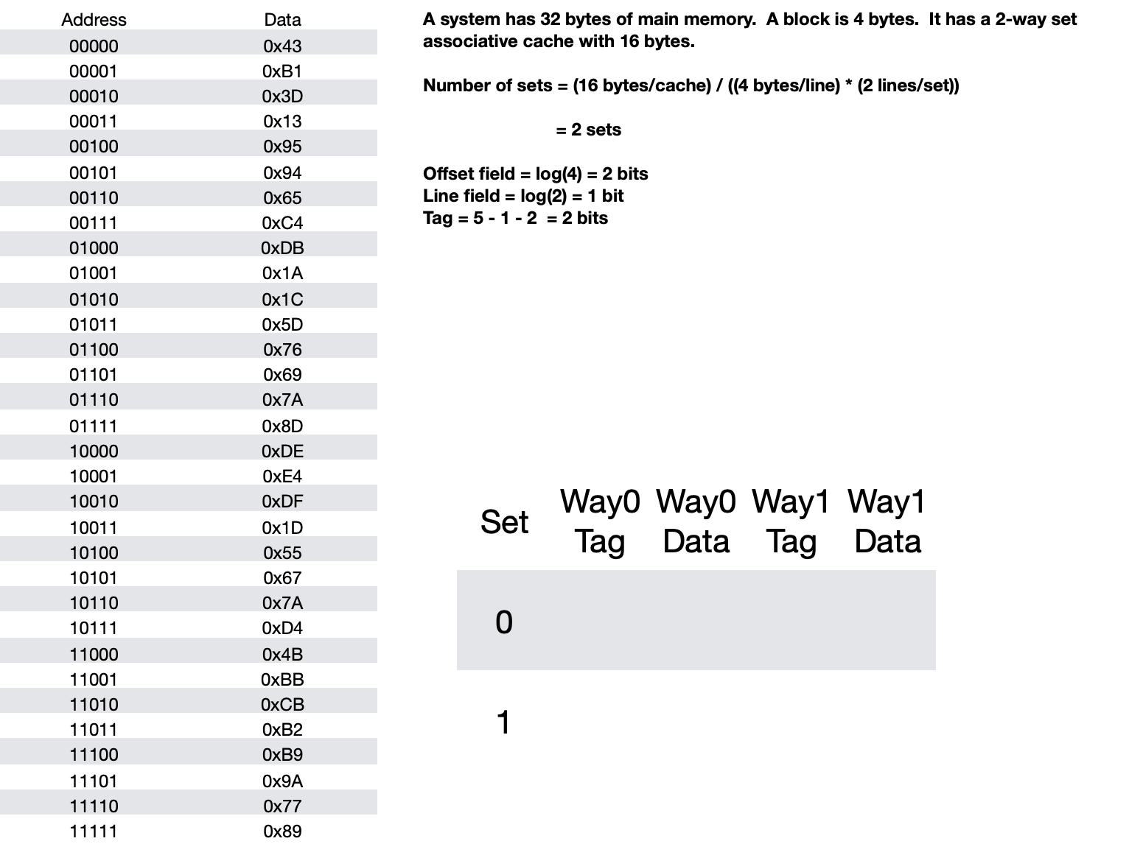
Example Problem 10 Step 1
Example Problem 10 Step 1

Slide 55
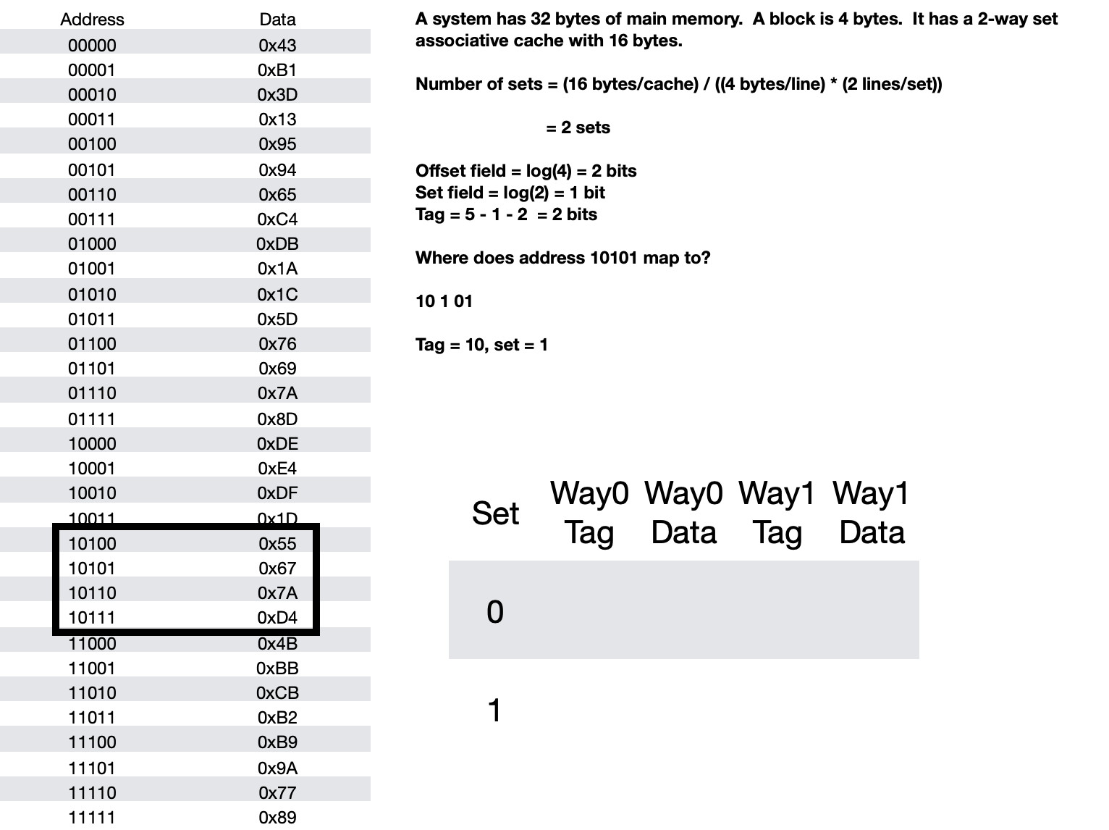
Example Problem 10 Step 2
Example Problem 10 Step 2

Slide 56
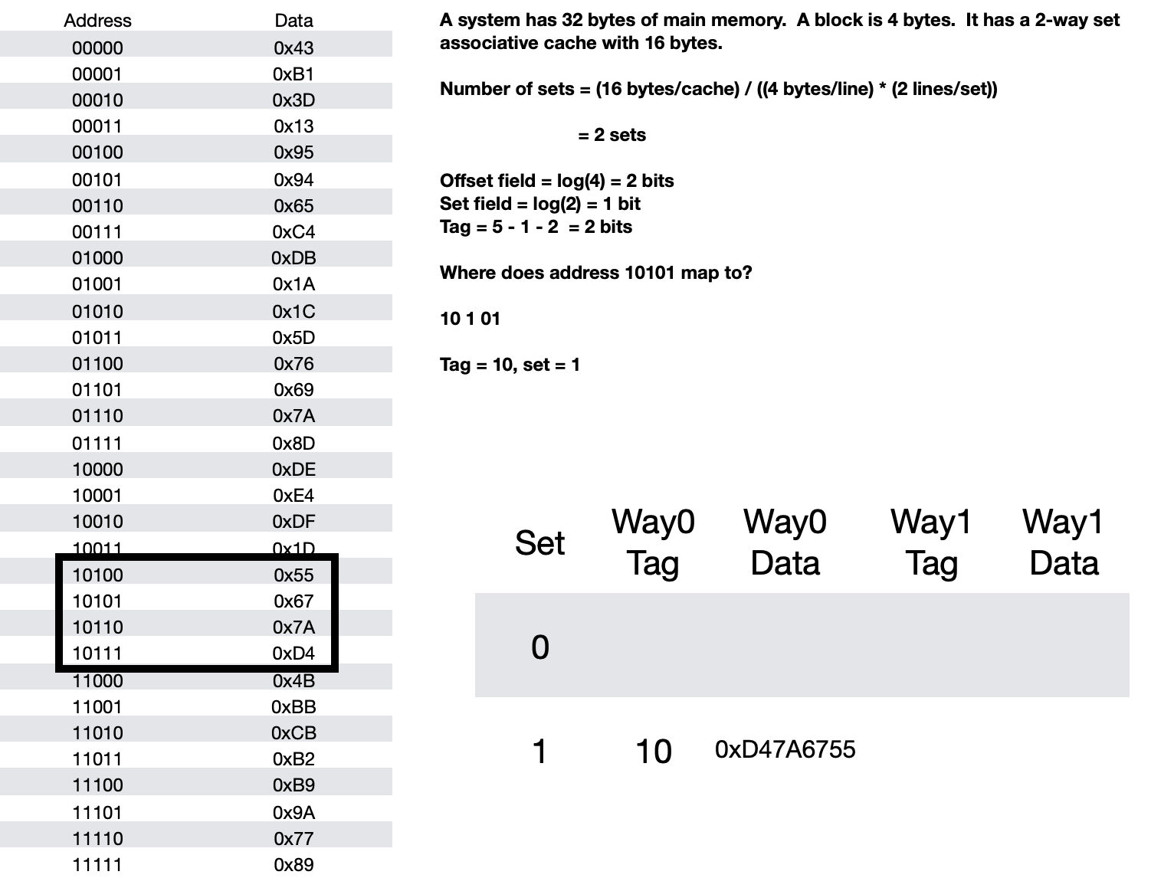
Example Problem 10 Step 3
Example Problem 10 Step 3

Slide 57
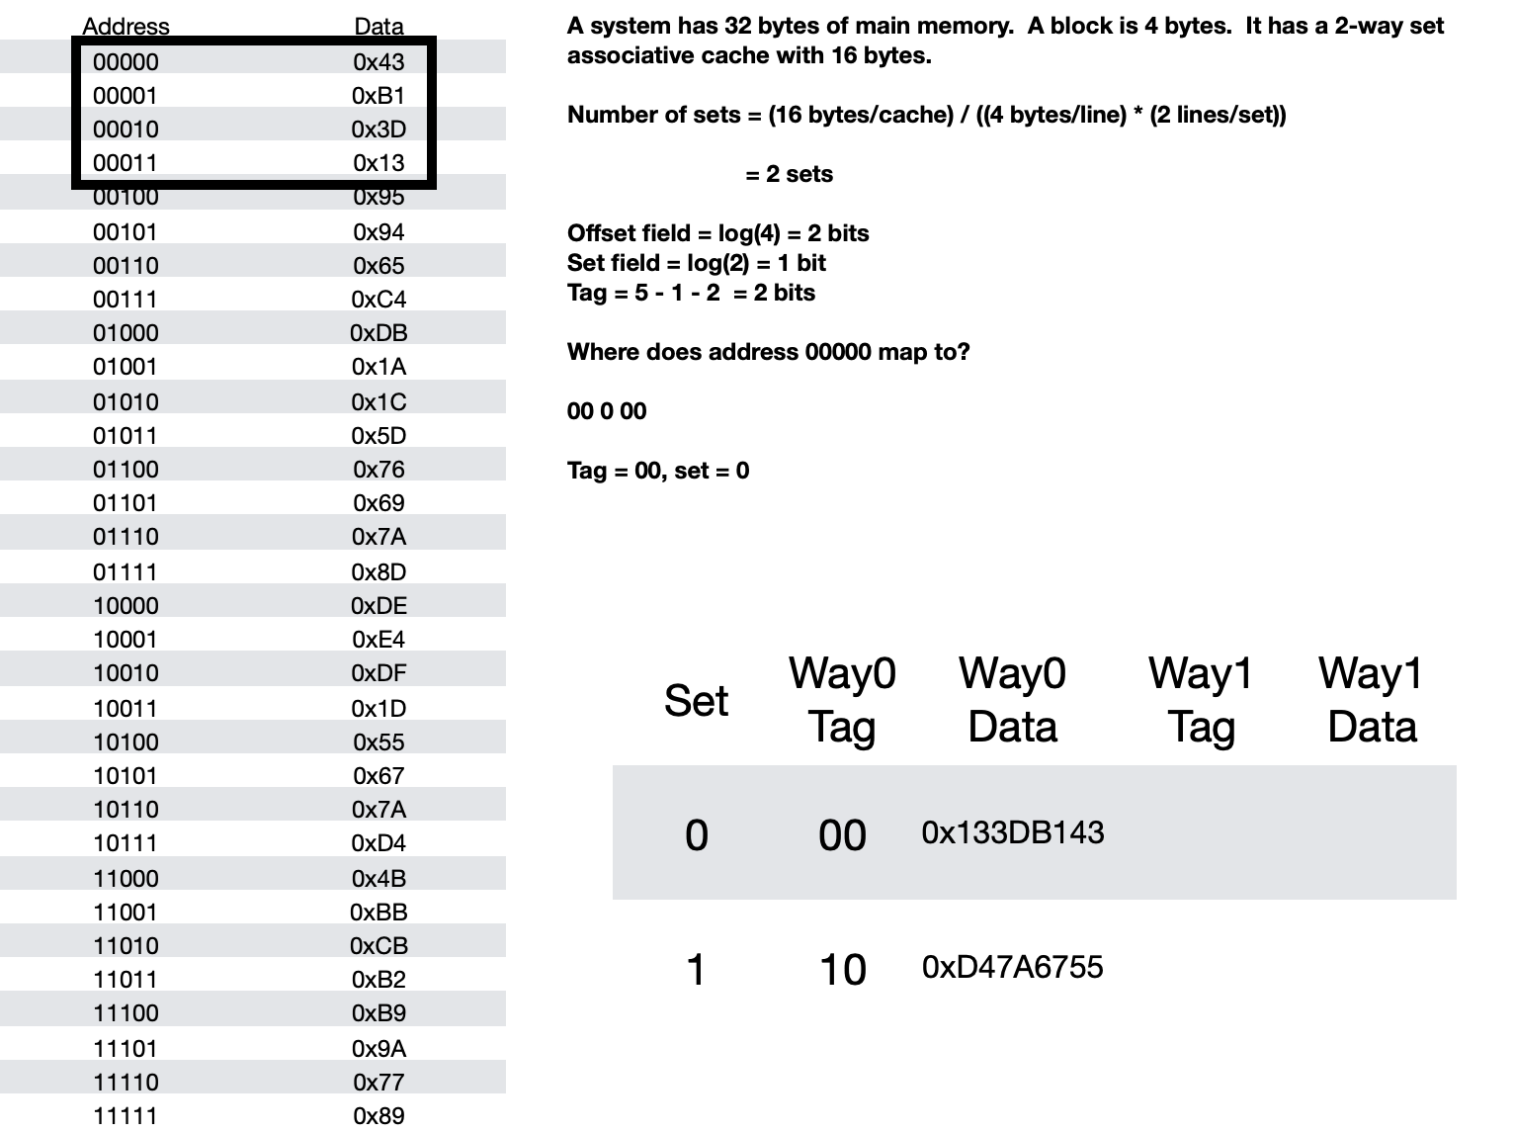
Example Problem 10 Step 4
Example Problem 10 Step 4

Slide 58
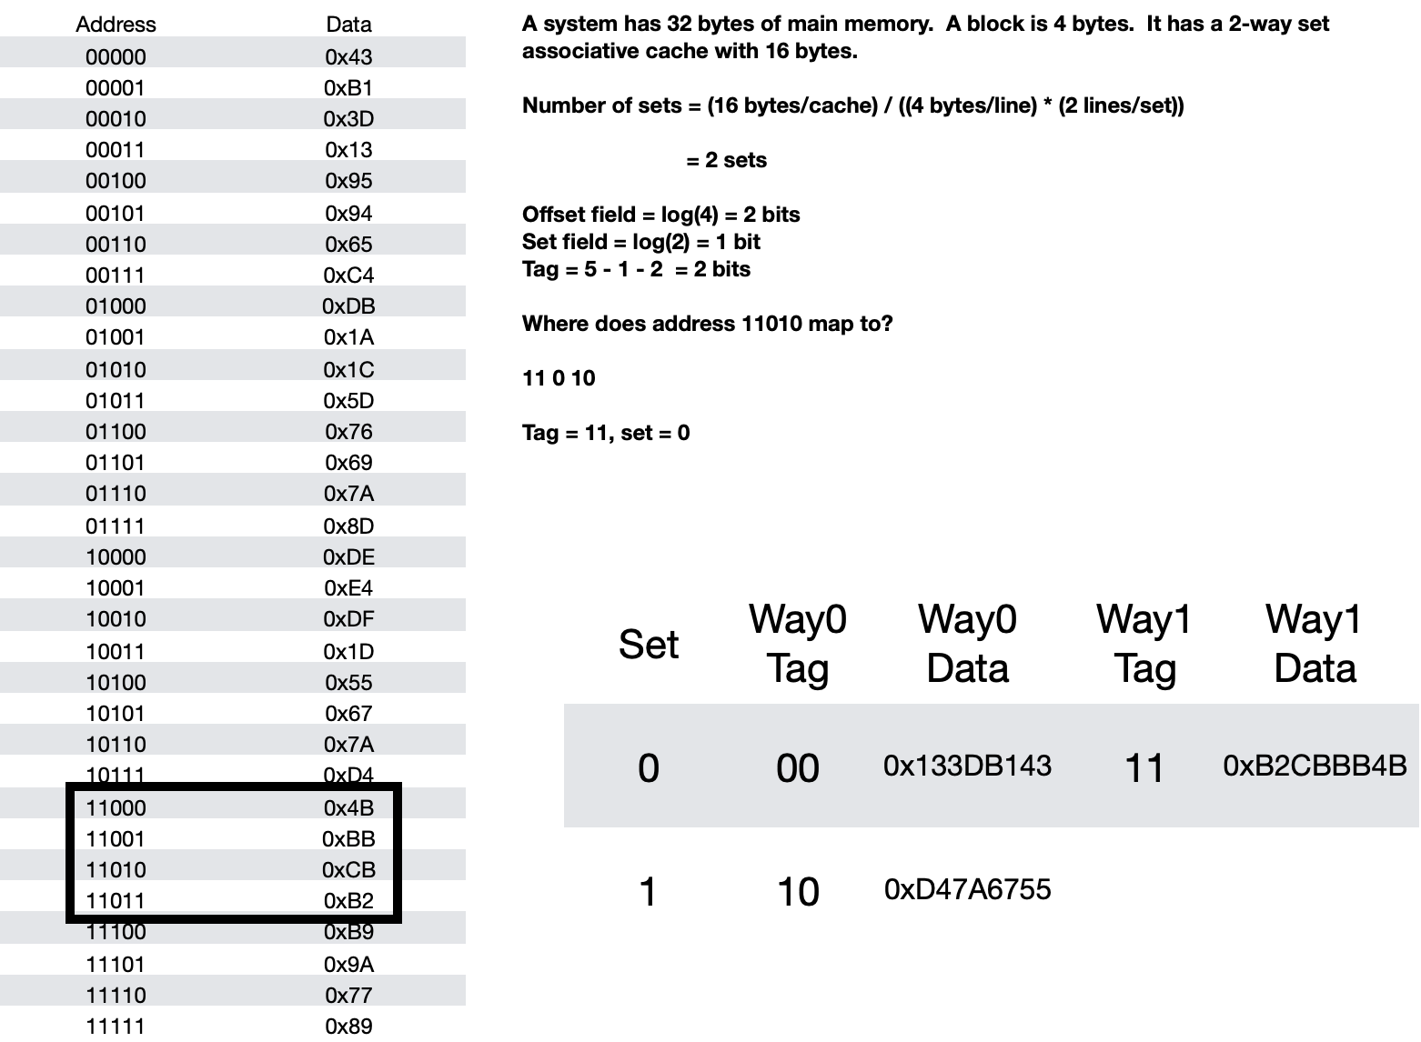
Example Problem 10 Step 5
Example Problem 10 Step 5

Slide 59
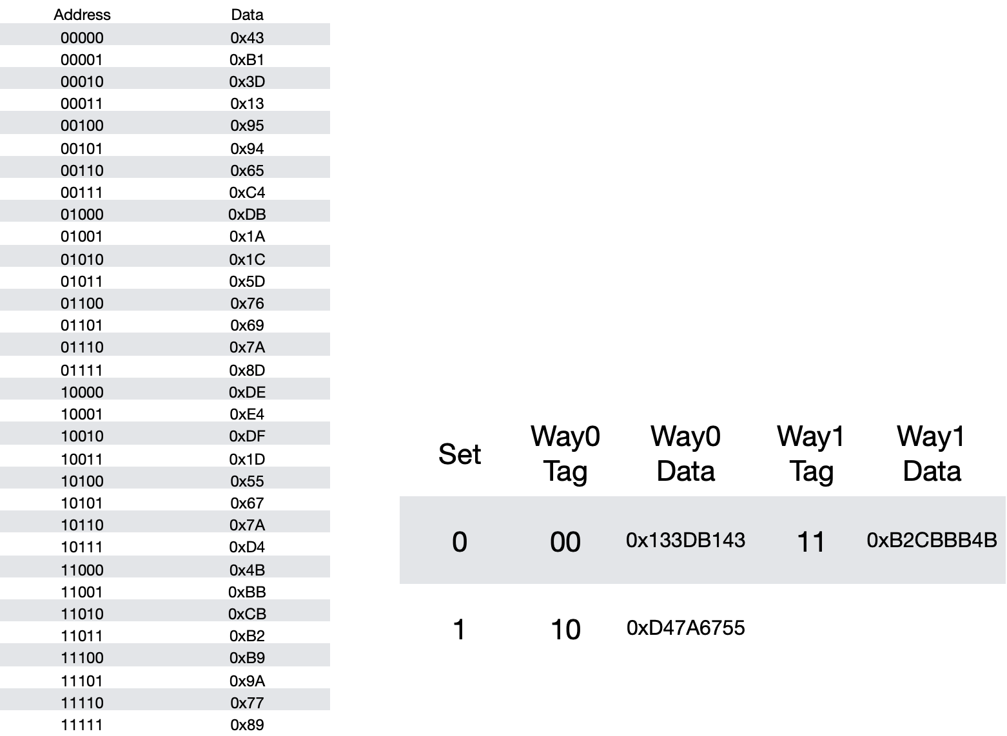
Example Problem 10 Step 6
Example Problem 10 Step 6

Slide 60
Example Problem 11
Example Problem 11
A system has a main memory of 2³² bytes with a 2⁵ byte block size.
It has a 4-way set associative cache with 2¹⁰ bytes.
How many bits are in the address?
What is the size of the offset field?
How many sets are there?
How many bits in the set field?
How many bits in the tag field?

Slide 61
Example Problem 11 Answer
Example Problem 11 Answer
A system has a main memory of 2³² bytes with a 2⁵ byte block size.
It has a 4-way set associative cache with 2¹⁰ bytes.
How many bits are in the address? 32 bits
What is the size of the offset field? log(25) = 5 bits
How many sets are there?
210 bytes/cache / (25 bytes/line * 4 lines/set) = 23 sets/cache
How many bits in the set field? log(2³) = 3 bits
How many bits in the tag field? 32-3-5 = 24 bits

Slide 62
Example Problem 12
Example Problem 12
A system has a main memory with 2³² bytes has a block size of 8 bytes and a cache size of 2¹⁰ bytes.
If address 0xABCDEEF0 is requested, and the cache is fully associative, what is the tag and what is the offset?
Where will the system look in the cache for the tag? How may possible places could this byte be if it is in the cache?

Slide 63
Example Problem 12 Answer
Example Problem 12 Answer
A system has a main memory with 2³² bytes has a block size of 8 bytes and a cache size of 2¹⁰ bytes.
If address 0xABCDEEF0 is requested, and the cache is fully associative, what is the tag and what is the offset?
Where will the system look in the cache for the tag? How may possible places could this byte be if it is in the cache?
The address is 32 bits. The offset field is log(8) = 3 bits.
The tag is 32-3 = 29 bits
ABCDEF0 = 1010 1011 1100 1101 1110 1110 1111 0000
10101011110011011110111011110 is the tag
The system will look in every line of the cache for the tag.
The data could be in any line. There are 2¹⁰ / 2³ = 2⁷ lines, so there are 2⁷ possible places this byte could be. It will look at the tag at every line in the cache, and if there is a match, then it is a hit.

Slide 64
Example Problem 13
Example Problem 13
A system has a main memory with 2³² bytes has a block size of 8 bytes and a cache size of 2¹⁰ bytes.
If address 0xABCDEEF0 is requested, and the cache is direct mapped, what is the tag, what is the line, and what is the offset?
Where will the system look in the cache for the tag? How may possible places could this byte be if it is in the cache?

Slide 65
Example Problem 13 Answer
Example Problem 13 Answer
A system has a main memory with 2³² bytes has a block size of 8 bytes and a cache size of 2¹⁰ bytes.
If address 0xABCDEEF0 is requested, and the cache is direct mapped, what is the tag, what is the line, and what is the offset?
Where will the system look in the cache for the tag? How may possible places could this byte be if it is in the cache?
The offset is log(8) = 3 bits
The number of lines in the cache = (2¹⁰ bytes/cache )/(8 bytes/line) = 2⁷ lines / cache
The line field is log(2⁷) = 7 bits
The tag field is 32 – 3- 7 = 22 bits
ABCDEF0 = 1010 1011 1100 1101 1110 1110 1111 0000
1010101111001101111011 1011110 000
Tag = 1010101111001101111011 line= 1011110 offset=000
The system will look in line 1011110 for the tag. There is one place it could be, at line 1011110. The system will look at line 1011110, and if the tag matches, it is a hit.

Slide 66
Example Problem 14
Example Problem 14
A system has a main memory with 2³² bytes has a block size of 8 bytes and a cache size of 2¹⁰ bytes.
If address 0xABCDEEF0 is requested, and the cache is 4-way set associative, what is the tag, what is the line, and what is the offset?
Where will the system look in the cache for the tag? How may possible places could this byte be if it is in the cache?

Slide 67
Example Problem 14 Answer
Example Problem 14 Answer
A system has a main memory with 2³² bytes has a block size of 8 bytes and a cache size of 2¹⁰ bytes.
If address 0xABCDEEF0 is requested, and the cache is 4-way set associative, what is the tag, what is the line, and what is the offset?
Where will the system look in the cache for the tag? How may possible places could this byte be if it is in the cache?
The offset is log(8) = 3 bits
The number of sets = (2¹⁰ bytes/cache) / (8 bytes/line * 4 lines/set) = 2⁵ sets/cache
There are log(2⁵) = 5 bits in the set field
There are 32 – 3 – 5 = 24 bits in the tag field
ABCDEF0 = 1010 1011 1100 1101 1110 1110 1111 0000
101010111100110111101110 11110 000
Tag = 10101011110011011110 set= 11110 offset=000
The system will look in set 11110. There are four possible places that this byte could be. Set 11110 has four lines in it, it will look at the tag values of these four lines to see if there is a match. If there is, it is a hit.

